Slide 1
RUNGTA COLLEGE OF DENTAL SCIENCES & RESEARCH
TITLE OF THE TOPIC : Biomechanics of edentulous states
DEPARTMENT OF PROSTHODONTICS AND CROWN & BRIDGE

Slide 2
Specific learning Objectives
At the end of this presentation the learner is expected to know ;
Core areas* | Domain ** | Category #
Introduction | Cognitive | Must Know
Biomechanics of natural dentition | Cognitive | Must Know
Biomechanics of complete denture | Cognitive | Must Know
Conclusion | Cognitive | Must Know
Take Home Message | Cognitive | Must Know
References | Affective | Desired to know

Slide 3
Table of Content
Introduction
Biomechanics of natural dentition
Biomechanics of complete denture
Conclusion
Take home Message
References

Slide 4
INTRODUCTION
Biomechanics is a science that deals with placing a mechanical object (such as a dental prosthesis) in a biological environment so that they both work in harmony with each other.
Edentulism is due to various combinations of cultural, financial, and dental disease ,attitudinal determinants, as well as to treatment received in the past.
Perceptions of the edentulous state may range from feelings of inconvenience to feelings of severe handicap.
Total loss of teeth = loss of a body part

Slide 5
MAIN FACTORS AFFECTING BIOMECHANICS
Mucosa
Alveolar (residual) ridge
Age changes
Occlusion
Habits

Slide 6
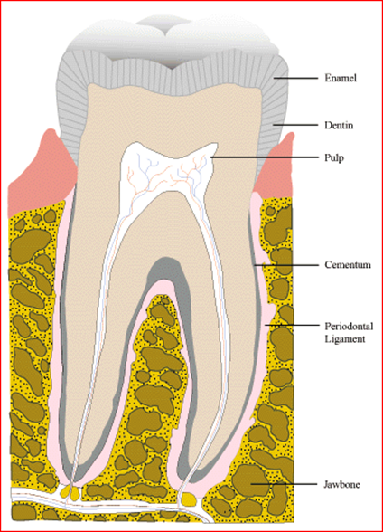
Support mechanism for the natural dentition
SUPPORTING TISSUES
The masticatory system is made up of closely related morphological, functional, and behavior components.
The masticatory apparatus is involved in the trituration of the food,with help of teeth and its supporting tissues.

Slide 7
PERIODONTIUM
Support is provided by periodontium, an organ composed of soft and hard connective tissues.
The periodontium attaches the teeth to bone of the jaws, providing a resilient suspensory apparatus resistant to functional forces.
Hard connective tissue - cementum and bone
Soft connective tissue - periodontal ligament and gingiva.
Completely edentulous patient is deprived of periodontal ligament support.

Slide 8
PERIODONTIUM
The approximate area of periodontal ligament is 45 cm2 in each arch.
Acts with the viscoelasticity,sensory mechanism and osteogenesis regulation potential to cope with the diverse directions, magnitudes and different forms of occlusal loading.

Slide 9
MASTICATORY SYSTEM
Occlusal forces exerted on the teeth are controlled by the neuromuscular mechanism of masticatory system.
Reflex mechanisms with receptors in the muscles, tendons,joints and periodontal structures regulate Mandibular movements
The greatest forces acting on the teeth are normally produced during mastication and deglutition(500/day).
Tooth contacts during swallowing are of longer duration than those occurring during chewing.
These forces increase steadily (depending on the nature of the food), reach a peak and abruptly return to zero.

Slide 10
MASTICATORY SYSTEM
The greatest forces acting on the teeth are normally produced during mastication and deglutition(500/day).
Tooth contacts during swallowing are of longer duration than those occurring during chewing.
These forces increase steadily (depending on the nature of the food), reach a peak and abruptly return to zero.

Slide 11
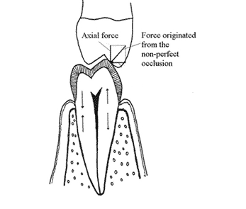
MASTICATORY SYSTEM
The direction of the forces is perpendicular to the occlusal plane.
The forward angulation of most natural teeth leads to the introduction of a horizontal component that tends to tilt the teeth medially as well as buccally or lingually.
Upper incisors may be displaced labially with each biting thrust, and these tooth movements probably cause proximal wear facets to develop.
Teeth are in occlusion during the functional movements of chewing and deglutition and during parafunctional too, i.e clenching and grinding

Slide 12
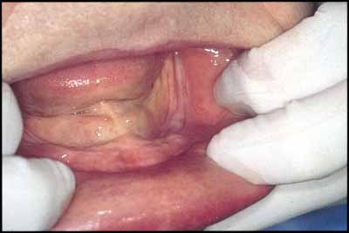
Bio mechanism for complete denture
Unsuitability of the tissues supporting complete dentures for load bearing function should be recognized.
The mucous membrane is forced to serve an identical purpose as the periodontal ligaments

Slide 13
Mucosal support and Masticatory loads
The mean denture-bearing area to be 22.96 cm2 in the edentulous maxillae and approximately 12.2cm2 in an edentulous mandible.
They are in dramatic contrast with the 45-cm2 area of periodontal ligament available in each dental arch.
Maximal bite forces appear to be five to six times less for complete denture wearers than for persons with natural teeth.
44 Ib (20 kg) for the natural teeth and 13 to 16 Ib (6 to 8 kg).

Slide 14
RESIDUAL RIDGE
The residual ridge consists of-
denture bearing mucosa
submucosa
periosteum
underlying residual alveolar bone.

Slide 15
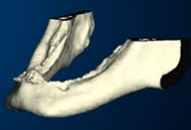
RESIDUAL RIDGE
In edentulous arch the alveoli that contained roots of the teeth fill in with new bone.
This alveolar process becomes residual ridge which is the foundation for the dentures.
A variety of changes occur in the residual bone after extraction and use of complete dentures
Function can modify the internal structure of human bone.
Pressure can cause its resorption.
Tension can cause bone deposition in some situations

Slide 16
Great variations in the degree of bone loss –
Anterior region of the mandible is 4 times more affected than the maxillary ridge
It benefits from the presence and support of the palate and from a larger denture bearing area.
The mandibular residual ridge widens as the resorption occurs.
The denture-bearing area (basal seat) becomes progressively smaller as residual ridges resorbs.

Slide 17
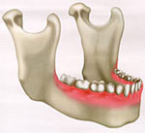
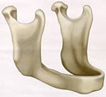
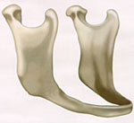

Slide 18
Oral mucosa
Varies in structure from area to area and demonstrates adaptation to function.
Hard palate which has to withstand the forces developed during the mastication of rough foods, the epithelium is normally keratinized.
Floor of the mouth is protected from masticatory forces by the tongue, the epithelium is thin and not normally keratinized.
Oral habits, such as cheek biting, can provoke a normally non-keratinizing epithelium of the cheek to become thickened and keratinized.

Slide 19
Oral mucosa
Over extension of a denture flange in one patient will produce little discomfort and perhaps a hyperplastic response from the tissue.
In another patient there can be early ulceration and no repairing.
From the prosthodontist's point of view, there is a wide range in the consistency of the oral mucous membrane.
Alveolar ridges covered with thick, resilient mucous membrane; others have thin atrophic membranes with little sub epithelial connective tissue

Slide 20
Tongue
Altered size and orientation of the tongue.
The tongue frequently responds to the loss of posterior teeth and alveolar bone by changing size to bring its lateral borders into contact with the buccal mucosa.
The intrinsic tongue musculature reorganizes the shape of the tongue to conform to the altered space available.

Slide 21
Age changes
Most common is the nodular varicose enlargement of the veins on the ventral surface of the tongue (caviar tongue).
The oral mucosa in the advancing age is often thin and easily abraded, and patients complains of dryness.
The edentulous residual ridge receives vertical, diagonal, and horizontal loads applied by a denture.
Surface area much smaller than the total area of the periodontal ligaments of all the natural teeth

Slide 22
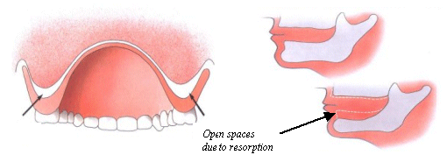
Age changes
Wearing dentures is invariably accompanied by an undesirable and irreversible
bone loss.

Slide 23
Two major physical factors involved in denture retention, under the control of a dentist.
1) Maximal extension of the denture base.
2) Maximal intimate contact of the denture base and its basal seat.

Slide 24
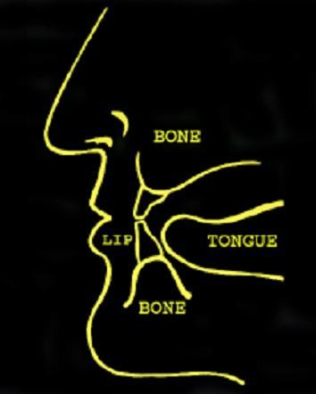
Arrangement of the artificial teeth is done to occupy a "neutral zone“ in the edentulous mouth, so the teeth will occupy a space determined by the functional balance of the orofacial and tongue musculature
( Buccinator ,orbicularis oris, intrinsic and extrinsic muscles of tongue )

Slide 25
Psychological effect on retention
The nervous influences that result may affect salivary secretions that affect retention.
This muscular stabilization of dentures is probably also accompanied by a reduction in the actual physical forces used in retaining their dentures

Slide 26
The primary components of human occlusion -
(1) Neuromuscular system
(2) Dentition & craniofacial structures

Slide 27
Neuromuscular factor

Slide 28
Neuron : muscle fibers for masticatory muscles 1:900
Electromyography has demonstrated that mandibular elevator muscle show strong activity during swallowing
Neuromuscular dentistry considers the entire system that controls the positioning and function of your jaw: teeth, muscles and joints.
The neuromuscular dentist seeks to establish a harmonious relationship among these factors, resulting in a position that is called neuromuscular occlusion.

Slide 29
Healthy adult dentition
Dental adaptation (wearing, drifting, extrusion)
Bone adaptation is reparative
Learned protective reflexes and functional adaptation.

Slide 30
Edentulous state
Residual ridge reduction
Compromised reflex adaptability
Possible increase in parafunctional movements
Increased risk of maladaptive denture wearing experience.

Slide 31
Edentulous state
When an adult dentition begins to deteriorate then fixed or removable prosthodontic therapy is attempted to maintain a functional occlusal equilibrium.
The artificial occlusion serves in an environment characterized by constant change that is mainly regressive.

Slide 32
MASTICATION
Mastication consists of a rhythmic separation and apposition of the jaws.
Mastication is the action of breaking down of food, preparatory to deglutition.
It integrates various components of the masticatory system - teeth and their investing structures, muscles, temporomandibular joints, lips, cheeks, palate, tongue, and salivary secretions.

Slide 33
MASTICATION
The second premolars and second molars of both jaws and the first molars of upper jaw had shorter life spans than other kinds of teeth.
Gravimetricsieve analysis, which measures the degree of crushing when a test food is masticated a specific number of times.
Masticatory efficiency in the one molar missing corresponded to about 40% of the complete dentition.
(Effects of aging on mastication by Masanori Nagao published in December 1992 edition of nutrition review )

Slide 34
Dentures and masticatory efficiency
Bridge – 66.5% , RPD – 24.2% , CD – 20.2%
Masticatory efficiency in bridge restorations was recovered to that of a complete dentition in 70% of the subjects.
More masticatory strokes are needed for RPD and CD wearer to crush food adequately.

Slide 35
Dentures and masticatory efficiency
Incising food is most difficult chewing task; crushing food is relatively easy and swallowing is easiest action for complete denture patient.
During masticatory movements, the tongue and cheek muscles play an essential role in keeping the food bolus between the occlusal surfaces of the teeth.
The teeth must be placed within the confines of a functional balance of the musculature i.e neutral zone

Slide 36
Main differences b/w patients having natural teeth and
having complete dentures
Mucosal mechanism of support as opposed to support by periodontium
Movements of denture during mastication
Progressive change in maxillomandibular relation
Different physical stimuli to sensor motor system

Slide 37
Changes in morphological face height
Morphological face height increases with age in persons possessing an intact or relatively intact dentition.
A premature reduction in morphological face height occurs with attrition or abrasion of teeth.
The articular surfaces of the temporo­mandibular joints are also involved.
At these sites growth and remodeling are mediated through the proliferative activity of the articular cartilages.

Slide 38
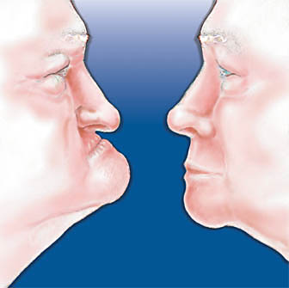
The reduction of the residual ridges under complete dentures tend to cause reduction in total face height and a resultant mandibular prognathism.

Slide 39
TAKE HOME MESSEGE
A good understanding of the sequeale of tooth loss to edentulous state helps to plan the good treatment options for the patient.
Prosthetic treatment for patients require accurate diagnosis for systemic and local factors (biomechanical) before attending to the design of the dentures.

Slide 40
REFERENCES
Prosthodontics treatment for edentulous patients by Carl .O Boucher
Essentials of complete denture by Winkler

Slide 41
THANK YOU

